Slide 1

ERICSSON Catalog Manager Ericsson Order Care
2015 USER Webinar

Slide 2




Today’s Agenda
20 min
20 min
15 min
10 min
20 min (room for up to 3 minutes over each)
ERICSSON VISION AND STRATEGY
ERICSSON CATALOG MANAGER RELEASE 14 ENHANCEMENTS AND ROADMAP
ERICSSON ORDER CARE RELEASE 14 ENHANCEMENTS AND ROADMAP
BEST PRACTICES FOR UPGRADING TO 14.X
WRAP-UP AND Q&A

Slide 3




Our Presenters
Robert Emery
Head of Product Management
Sunny Auluck
Strategic Product Manager
Richard Huffman
Strategic Product Manager
Jeff Christian
Delivery Manager
MODERATOR
& WELCOME
ERICSSON CATALOG MANAGER R14
ERICSSON ORDER CARE R14
MIGRATING TO R14.X

Slide 4
Investment DRIVERS in Lead-to-Service
Automate to reduce OPEX
IMPROVING FINANCIAL EFFICIENCY
Address subscriber growth in new technology services
CxO TOP PRIORITIES
ENHANCING CUSTOMER EXPERIENCE
Create new initiatives to counter OTT services
INCREASING AND ACCELERATING REVENUE
Source: Analysys Mason 2014 Fulfillment Market Drivers
Notes:
Analysis Mason 2014 Fulfillment Market drivers:
Increasing subscriber numbers in emerging markets and for new-generation technology services
Growth in the number of connected devices
CSP initiatives to counter OTT services
Take-up of M2M services
New packet network technology deployments
System convergence
Investments in automation to reduce opex
‘Double-sided’ business models
Focus on enterprise and SME markets
National broadband infrastructure stimulus programmes
CSPs offering cloud services

Slide 5

SERVICE AGILITY
ORDER CYCLE TIME
↓
5 Days ↓ 5 MINUTES
Tier 3 Caribbean Incumbent
ORDER FALLOUT
↓
40% ↓ 4%
Tier 1 South American Operator
concept to SALES
↓
REALIZED
18 MOS ↓ 2 WEEKS
Leading European Operator
Notes:
Ericsson Lead-to-Service Suite bring real results to real customers.
When its comes to operational efficiency, operators can:
Achieve a faster and cheaper fulfillment of complex service orders due to efficient automation and process orchestration
Reduce operational expenses by coordinating the most suitable provisioning processes – even for the most complex products
Reduce service order fallout due to a more consistent, well-structured process orchestration
Increase operational flow-through by making well-structured components and workflows and other assets available to third-party service partners via APIs
When it comes to OSS/BSS, marketing, product management and catalog management, operators can:
Reduce time-to-market of new services by providing a common terminology across their business for products and their definitions
Increase customer satisfaction through a centralized platform that enables consistent support for products
Reduce service creation costs by promoting component reuse
Quickly meet new customer requirements by using flexible product structures

Slide 6
Ericsson Acquisition is Driving Product Growth
Customer Deployments Added by Year
ConceptWave
Ericsson
P1

Slide 7
Ericsson portfolio Strategy
UP FRONT INVESTMENT EFFICIENCY
RECURRENT COSTS OPTIMIZATION
ENABLING TRANSFORMATION JOURNEY
BUSINESS SOLUTIONS
INDUSTRIALIZED SOFTWARE PLATFORMS
COMMON CHARACTERISTICS
Notes:
... From the bottom we have 3 main strategic components/initatives:
- Common Characterstics => Architecture principles and common execution environment., «how we put all component togheter»
- Platform => how we realize the single «block» (SW components) of the architecture
- Business Solution => how we use architecture and SW platform components to address specific customer need
=> Strategy principles of our solutions
These strategic components form the base for our OSS/BSS portfolio which is:
Process driven -> software products not only supporting a specific functional role, but also adapted to fit the lifecycle of our customers business processes
End-to-End -> covering each process end-to-end, organinc and in-organic efforts. Evolving our OBS portfolio to meet the needs of the market
Business Suites –> pre-integrated solutions that meet our customers need (repetitive offering scenarios), with speed time to market and minimize deployment costs and TCO. Pre-integration of software components to meet the needs of a business process; e.g. L2S, S2C etc
Goals of our Strategy:
- Optimize cost either investment and recurrent
- Enabling simple / effective transformation

Slide 8
Ericsson SERVICE INNOVATION framework
Multi-service & multi-channel
Real-time processes
Catalog and network driven
Single architecture
Time-to-market
Total cost of ownership
User experience
Innovation
Customer retention
Market share
Enterprise
Operator
Consumers
Developers
Partners
Digital Channel Interaction
Improved
Catalog-Driven Processes
Fulfillment
Assurance & Analytics
Charging & Policy
Unified Inventory
Network Design
Activation
Network & Services
Legacy Systems
Notes:
Catalog driven composition to all the key management processes
“Componentization” of fulfillment, assurance, and charging & policy to provide faster product lifecycle management and easier IT maintenance
Real-time network services Leverage innovation strength of partners and vertical enterprises
Provides a common framework for exposure, browsing and composition of real-time services
All in all: Service Enablement + catalog driven business processes
Standards-Based Platform
Retooling of OSS/BSS creating an NGOSS information platform
Enabling transition to SDN and NFV service-centric network
Process Consistency
Synchronized product catalog, order handling, inventory management, provisioning automation, and data management leading to consistent customer experience
Greater Efficiency
Faster in-service of new network
Faster service provisioning with fewer errors
More accurate and real-time network and service inventory information
Unified ordering and provisioning
More Value from Network
Improved and real-time network asset visibility
Proactive and accelerated capacity planning
Better data quality and consistency

Slide 9
Catalog driven OSS/BSS
Leverage Partners, Agents, Self-Care
Catalog-driven processes
Monitor & Assure
Negotiate & Quote
Full product lifecycle management
Stand-alone
Componentized processes
Charge & Bill
Handle Order
Embedded
Coordinated configuration
Enterprise
catalog
Pre-integrated
Apply Policy & Deliver in Real-time
Provision & Activate
Assembly and reuse
Analytics
Notes:
Catalog driven business processes is an essential approach to reach agility.
The catalog manger product aquired by ConceptWave is the engine to realize the catalog driven OSS/BSS.
Our approach is based on:
A single enterprise catalog that drives all phases of the product lifecycle
A catalog capable of modeling the end-to-end view of a product offering, from pricing through to network policy
A catalog that can provide both real-time services and publish domain-specific views of other systems
An OSS/BSS portfolio that automatically and seamlessly integrates the enterprise catalog data without manual intervention
Some key values:
Define and launch new products in days, and new promotions in minutes
Manage the entire lifecycle of a product in one place
Immediately sell, activate, charge/bill and deliver across all sales channels
The Catalog relation with OBS portfolio is threefold:
As part of stand-alone, self-contained offerings (Catalog Manager, Order Care) that can be added on top of/integrated with legacy 3PP environments
Embedded – techology is as part of other Ericsson offerings (next gen CS/CBiO, SIF, Ericsson Catalog Manager)
Pre-integrated with other core E/// OSS/BSS offerings like CBiO, SEP, EMA, EEM…

Slide 10
Software-as-a-Service
Cloud Readiness
Virtualization Ready
Cloud Ready
Cloud Technology
Multi-Tenant
Commercial Models
Shrink wrapped solutions
Onboarding
Pay-as-you-go models
Platform
Product

Slide 11
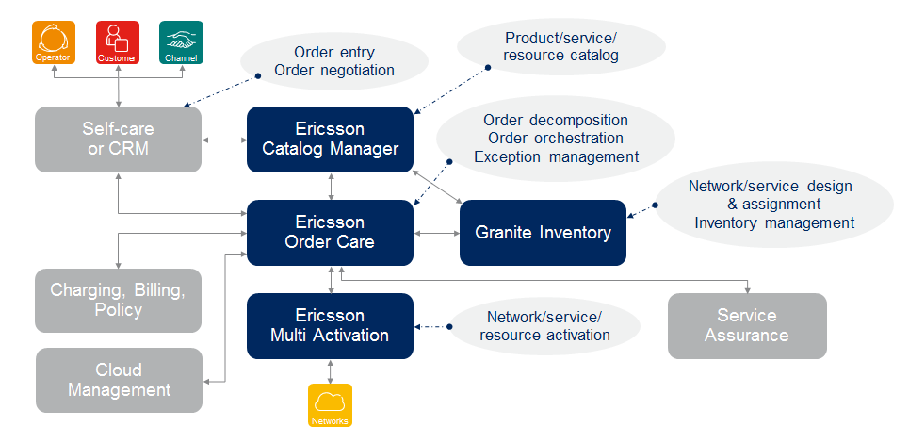
Lead-to-Service Suite
More commonality, more pre-integrations, more use cases

Slide 12
Common Characteristics
Consolidate and align OSS/BSS fundamentals to foster innovation and growth
Provide a unified approach to all end users, delivering a consistent experience, easing training, and simplifying cross-product use
User Experience
Define a reference architecture that promotes integration of OSS/BSS applications and seamless exchange of information
Architecture
Use modular building blocks to unify deployment, administration, monitoring and configuration, enabling low customer TCO
Platform
Provide a simplified licensing model that synchronizes commercial offerings, release management and licensing structures.
Commercials
Notes:
User Experience:
Alignment with Ericsson branding for acquired products
Usability & standards alignment
Unified reporting
Architecture
Cloud-enabled portfolio
Documented information architecture
TMF certification
Platform
Alignment to standardized platform and 3PP release levels
OSS/BSS Next Generation Execution Environment (NGEE)
Commercials
Value packaging
Standard release schedule
Standard release numbering

Slide 13

1st ERICSSON OSS User Group
We are planning first formal OSS-wide User Group
Nice, France
June 4-5 2015
Immediately following TM Forum Live 2015
An “operator run” event
Modelled on our successful BSS User Group
We will be communicating more details over the next few months

Slide 14
Release status Conventions
Released | Released Product or Feature. Products available for unrestricted global delivery (GA status) are defined as released products. There may be more than one (1) release in a product line available on the market.
Indicative | Future products or features where release intent has been defined and development has started for some objects. Release scope and the GA date may change.
Candidate | Potential products or features where implementation has not started. Candidates for scope are suggested. Release scope, functions and GA date may change.
Disclaimer: Ericsson (the Company) does not guarantee that the assumptions underlying any forward-looking statements are free from errors nor do they accept any responsibility for the future accuracy of the opinions expressed in this document or the actual occurrence of the forecasted developments.
Neither the delivery of this document nor any further discussions of the Company with any of the recipients shall, under any circumstances, create any implication that there has been no change in the affairs of the Company since such date. The Company is under no obligation to update or keep current the information contained in this material or in the presentation to which they relate and any opinions expressed in them are subject to change without notice. No representation or warranty (express or implied) is made as to, and no reliance should be placed on, the fairness, accuracy or completeness of the information contained herein and, accordingly, that neither the Company nor any of such person’s officers, directors or employees accepts any liability whatsoever arising directly or indirectly from the use of this document.
Notes:
IMS Roadmap Presentation IMS Roadmap Presentation IMS Roadmap Presentation IMS Roadmap Presentation
1/19/20152011-11-28
© Ericsson AB 2005-2010 © Ericsson AB 2005-2010 Ericsson AB 2005-2010 © Ericsson AB 2005-2010
14
IMS Roadmap Presentation IMS Roadmap Presentation IMS Roadmap Presentation
1/19/20152011-11-28
© Ericsson AB 2005-2010 Ericsson AB 2005-2010 © Ericsson AB 2005-2010
14
IMS Roadmap Presentation IMS Roadmap Presentation
Ericsson AB 2005-2010 © Ericsson AB 2005-2010
14
IMS Roadmap Presentation
2011-11-28
© Ericsson AB 2005-2010
14

Slide 15
Today’s Agenda
ERICSSON VISION AND STRATEGY
ERICSSON CATALOG MANAGER RELEASE 14 ENHANCEMENTS AND ROADMAP
ERICSSON ORDER CARE RELEASE 14 ENHANCEMENTS AND ROADMAP
BEST PRACTICES FOR UPGRADING TO 14.X
WRAP-UP AND Q&A

Slide 16
Ericsson Catalog Manager
Roadmap Focus Areas
ERICSSON
SERVICE
INNOVATION
FRAMEWORK
OSS/BSS
SOLUTION SUPPORT
ROLE BASED
WIZARDS
PLM
AGILITY IN SERVICE CREATION & DELIVERY
ERICSSON CATALOG
MANAGER
EXPERIENCE
EVOLUTION
LOGICAL
CATALOG
MODEL
CATALOG DRIVEN
OSS/BSS
CLOUD-READY
SAAS
INNOVATION

Slide 17
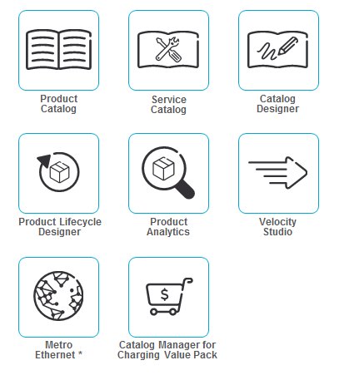
Ericsson CATALOG MANAGER Portfolio
Product Components
Supported Solutions
Ericsson Service Innovation Framework
Ericsson Mobile Order Management
Product Catalog
Product
Lifecycle
Designer
* Roadmap item; not available for tendering

Slide 18

ERICSSON catalog manager Roadmap
Enabling agility in service creation & delivery
Release 14.1
Release 14.2 (Previously15.0)
Release 16.0
Release 16.1
Innovation
Catalog driven Charging
Catalog Driven Policy
Catalog Driven Fulfilment
Efficiency
Mapping between Entities
Charging best practice modeled services
Evolution
Role based UI
New TMF Entities
Experience
Best Practice Tutorial
Demo
Innovation
Catalog driven including Wizard Based UI for Inventory, Revenue Manager
B2B Catalog Exchange
Efficiency
MEF best practice modeled services
Evolution
Look and feel improved
Publishing between instances
Innovation
Extend support for Catalog Driven including Billing, Self-Care and CRM
Efficiency
MEF best practice modeled services
Evolution
Lead to Service Offering Support
Experience
Look and feel improved
Demo
Innovation
Role Based Wizards
Enhance SPOC capabilities
Efficiency
Library of best practice modeled services
Evolution
SaaS Offering: Shared instance across many clients
Experience
Standard models for key 3PP vendors
14.0
14.1
14.2
16.0
16.1
Released
Indicative
Candidate
Q1
Q2
Q3
Q4
Q1
Q2
Q3
Q4
Q1
Q2
Q3
Q4
Q1
2014
2015
2016
Notes:
Take from BUC 10.2 SLA/SLS
Add Assurance for 14.2 from BUC 10.1A
Take 10.1B for Catalog driven Fulfilment CFF
10.3A for - Publishing between instances
BIS – Business Interaction Specification 10.3A (Need to discuss
this further)

Slide 19
Catalog-Driven Everything
Product Service Resource Catalog
Componentized Fulfillment, Assurance, Charging, Policy, Composition
Catalog- driven Everything
+
=
Benefits
Best practice and effective integration between systems
Best practice PLM defined ready for extensions
Defined use cases ready for extension

Slide 20
Catalog-Driven Everything
Leverage Partners, Agents, Self-Care
Monitor & Assure
Negotiate, Quote & Order
Milestones
Charge & Bill
Fulfillment
YE2013
YE2014
YE2015
Enterprise
catalog
Apply Policy & Deliver in Real-time
Provision & Activate
Analytics

Slide 21
Architecture
User Interface
Logical Model
Product View
Fulfillment View
Billing View
Charging View
Policy View

Slide 22
Architecture
User Interface
Logical Model
Publication Framework
Adaptors
Product View
Product Adaptor
Fulfillment View
Fulfillment Adaptor
Billing View
Billing Adaptor
Charging View
Charging Adaptor
Policy View
Policy Adaptor

Slide 23
Publishing
Publishing Framework
Cross-Adaptor Orchestration
Sequencing
Exception Management
Adaptor
Target System Publishing
Rollback
Mapping
Sequencing
Exceptions

Slide 24
Publishing
Publishing Framework
Cross-Adaptor Orchestration
Sequencing
Exception Management
Adaptor
Target System Publishing
Rollback
Mapping
Sequencing
Exceptions

Slide 25
Publishing
Publishing Framework
Cross-Adaptor Orchestration
Sequencing
Exception Management
Adaptor
Target System Publishing
Rollback
Mapping
Sequencing
Exceptions

Slide 26
Catalog Driven Policy, Charging, Fulfillment
Tutorial Ready
Roadmap
GA in Release 14.1
Plug and Play catalog models MEF, Quad-play in Release 16.0
Tried and Tested
SID Compliance
Context Driven
Thought Leader
Maximize Reuse
Componentized

Slide 27
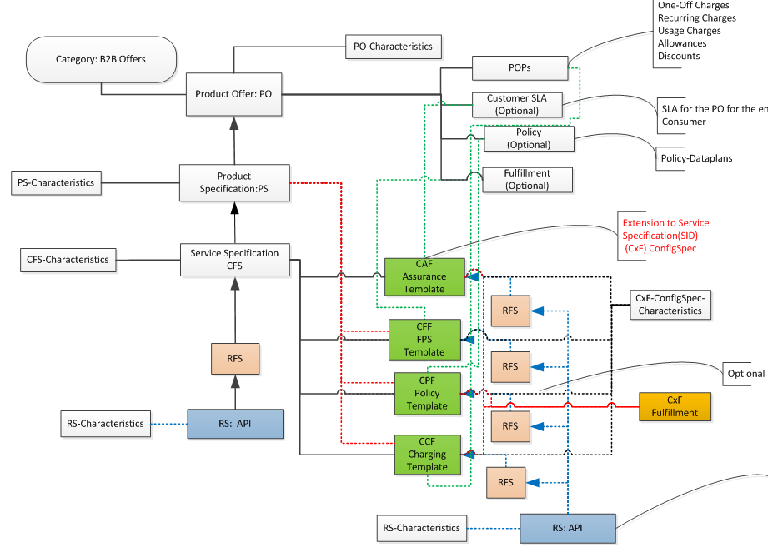
New Logical Model Entities
Release 14.1 GA
BENEFITS
TMF standards followed and implemented
Configured best practice solution packs defined
Reusable components
Proven item-based model kept intact
Increased efficiency through improved standardized User Interface
Product Offers
Product Specification
Service Specifications
Resource Specifications
CxF (Componentized Functions): CFF, CCF, CPF, …

Slide 28
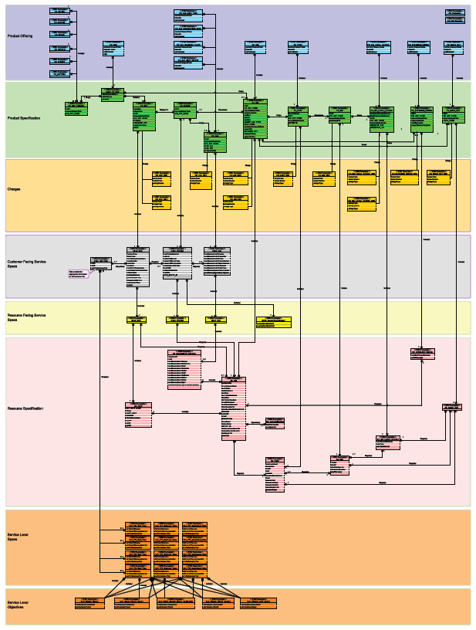

Pre-Configured Catalog
Release 14.1 GA
Product Offering
Product Specification
Full SID-based Product Service Resource (PSR) model
Charge
Customer Facing Service Spec.
Resource Facing Service Spec.
Resource Specification
Service Level Spec.
Service Level Objective

Slide 29
New Service & Resource Candidate entities
Release 14.1 GA
New entities are being defined as per TMF
Catalog to catalog interaction enabled
BENEFITS
Federate catalog data to 3rd party catalog, or
Federate resources such as router, CPE, etc. being provided by 3rd party into catalog
Notes:
For example we use ResourceCandidate for exposing our resources to 3rd party catalog such as
Or import resources such as routers, modems, CPE being provided by 3rd party resource catalog..
And for ServiceCandidate we would expose services such as voice, SMS etc. those to 3rd party and we would have fulfilment of those services based on service order generated by 3rd party.

Slide 30
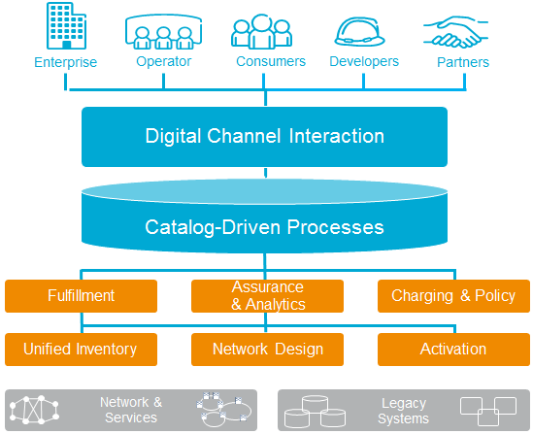
Digital Services
Release 14.1 GA
Faster Time-to-Market
Available Pre-integrated Solutions
Capture New Revenues
Notes:
For example we use ResourceCandidate for exposing our resources to 3rd party catalog such as
Or import resources such as routers, modems, CPE being provided by 3rd party resource catalog..
And for ServiceCandidate we would expose services such as voice, SMS etc. those to 3rd party and we would have fulfilment of those services based on service order generated by 3rd party.

Slide 31
Digital Services
Release 14.1 GA
API specification model creation based on SID model
Expose as offerings and allows for mash up that can be made available for ordering
RESTful APIs
SID / TMF based RESTful API support
Browse (Run Time)
Manage (Design Time)
Associate components Policy, Charging and Fulfillment to Digital API
How we do it
Notes:
For example we use ResourceCandidate for exposing our resources to 3rd party catalog such as
Or import resources such as routers, modems, CPE being provided by 3rd party resource catalog..
And for ServiceCandidate we would expose services such as voice, SMS etc. those to 3rd party and we would have fulfilment of those services based on service order generated by 3rd party.

Slide 32
Agility is key
+
+
=
CUSTOMER AGILITY
SERVICE AGILITY
NETWORK AGILITY
BUSINESS AGILITY
OUR AGILITY SUITE
Customer/Partner Management and Interaction
Plan-to- Provision
Idea-to- Implementation
Lead-to- Service
Service-to- Cash
Experience-to- Resolution
Data-to-Experience
Network & Cloud Management
Notes:
ELI
Explain what’s new here. Data-to-Experience and Cloud management.
<<CLICK>> The Agile Operator manages networks, services and customers. All at once.
Achieving CUSTOMER agility means operators must understand customer needs and have 3D insights and proactively acting to offer the right services, resolve problems and make customers feel in control. It’s about LEVERAGING DATA.
Achieving SERVICE agility means operators must find exponential business growth – through customers and partners – and delivering and monetizing new services rapidly and cost effectively. It’s about SPEEDING INNOVATION.
Achieving NETWORK agility means operators must accelerate the planning, rollout and optimization of new and existing networks while dealing with network, technology and organizational complexity. It’s about SIMPLIFYING COMPLEXITY.
When operators are successful at managing these elements, they’ve achieve BUSINESS agility; meaning they are in position to innovate and drive profitable growth through new and existing value chains.
<<CLICK>>OSS/BSS are the key to such innovation and profitable growth. Ericsson has built our OSS/BSS Agility Suite to be the foundation for business agility with 3 key ingredients: business focus, process-driven orientation, and comprehensive footprint. More on that in a moment…

Slide 33
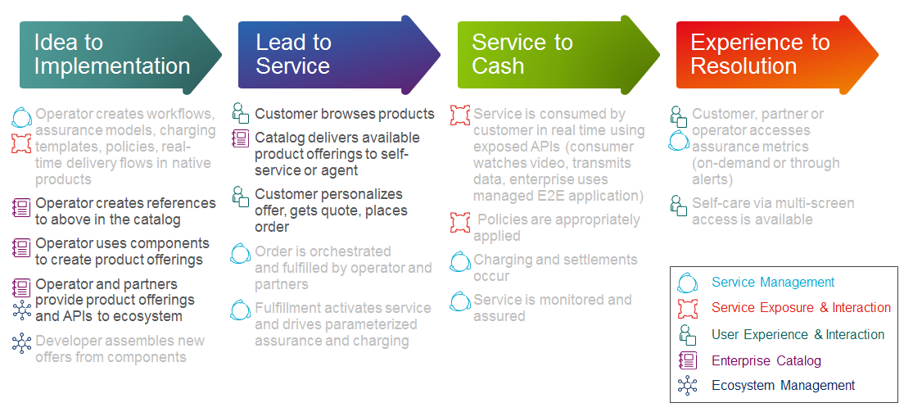
Agility Suite How IT WORKS
Framework Process Flow
Notes:
Walk through the flow keeping in mind that the “customer” can be an end-user or can be a business partner (using an operator- or partner-supplied component or full end-to-end product offering). To simplify the flow, the case depicted here is more of a consumer purchasing and using the full offering.

Slide 34
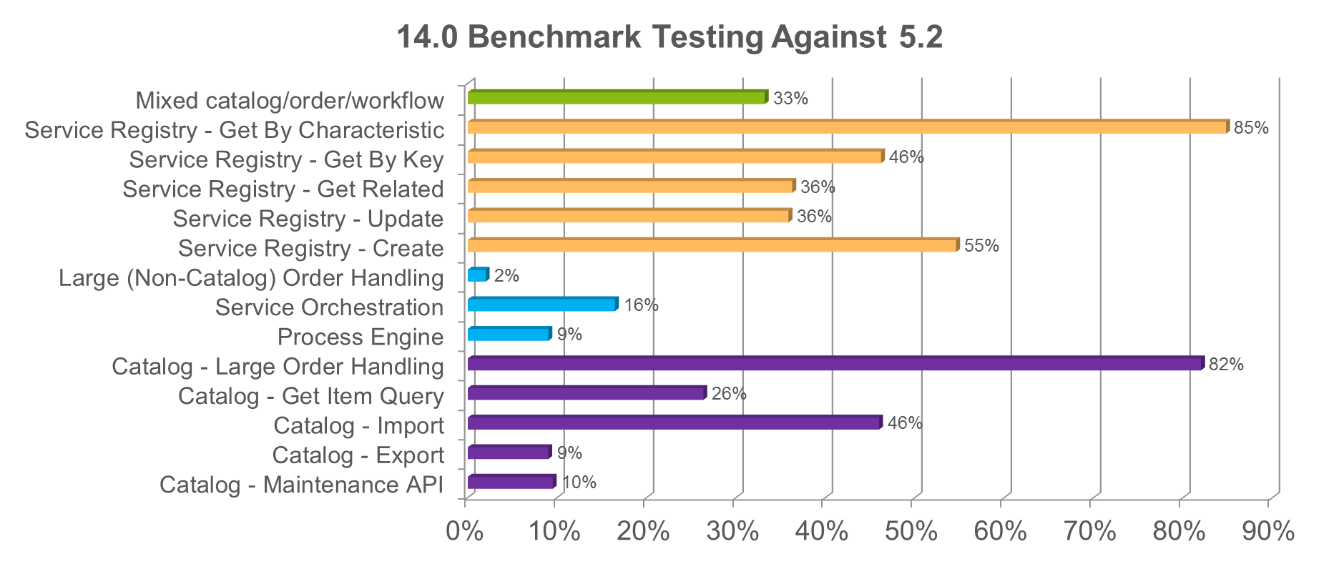
Performance Improvements Release 14.0 vs 5.2

Slide 35
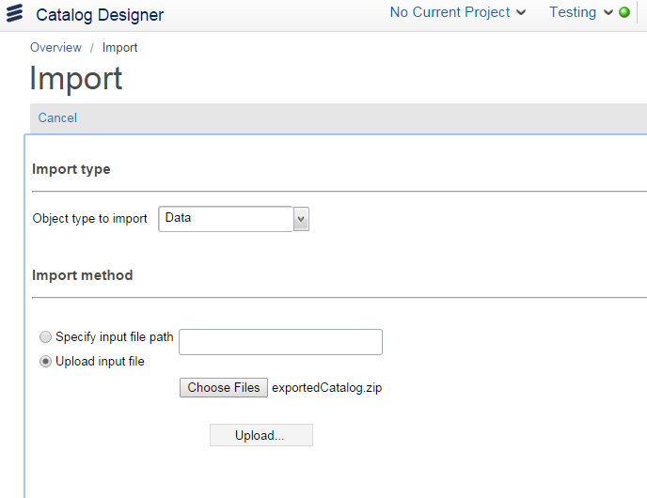
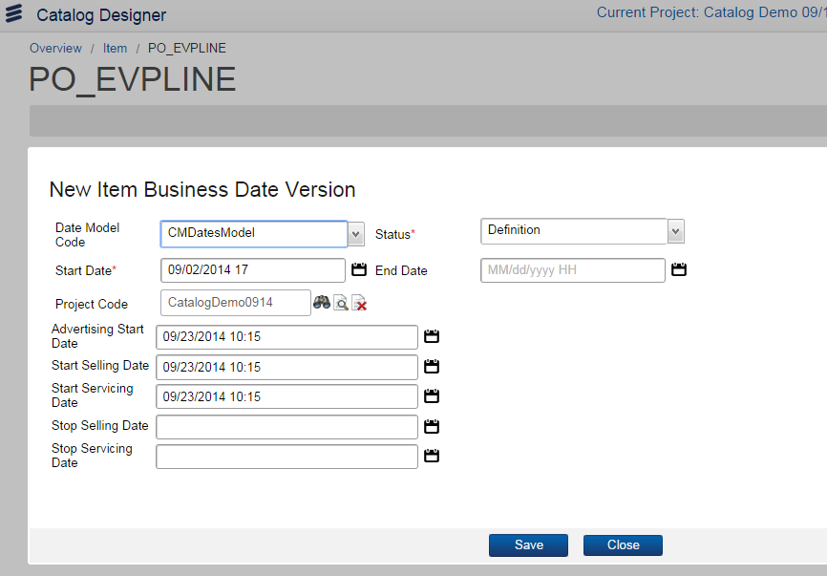
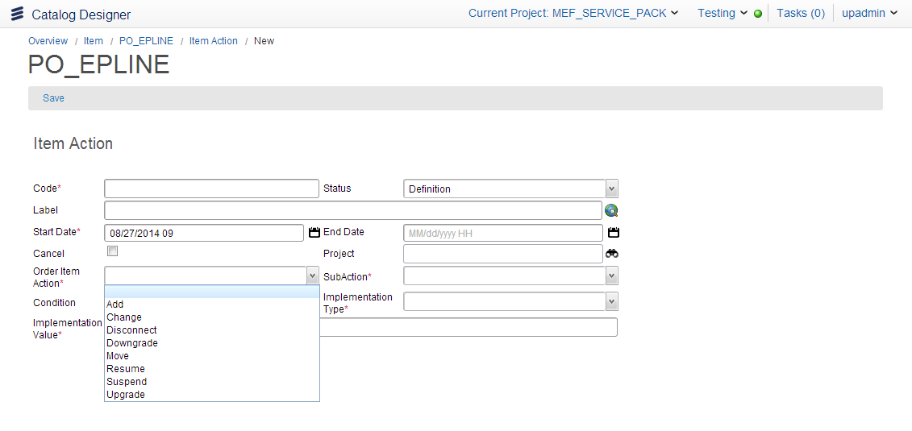
usability and performance
Release 14.0 GA
Improved import/export functionality using available Zip file import in both Catalog Designer and the command line
Business dates - each catalog item can now distinguish between the numerous business dates, and new ones can be added
Rules or events are contained in a new item association object called “Actions”
Notes:
Zip file import contains
Each object is within this file

Slide 36
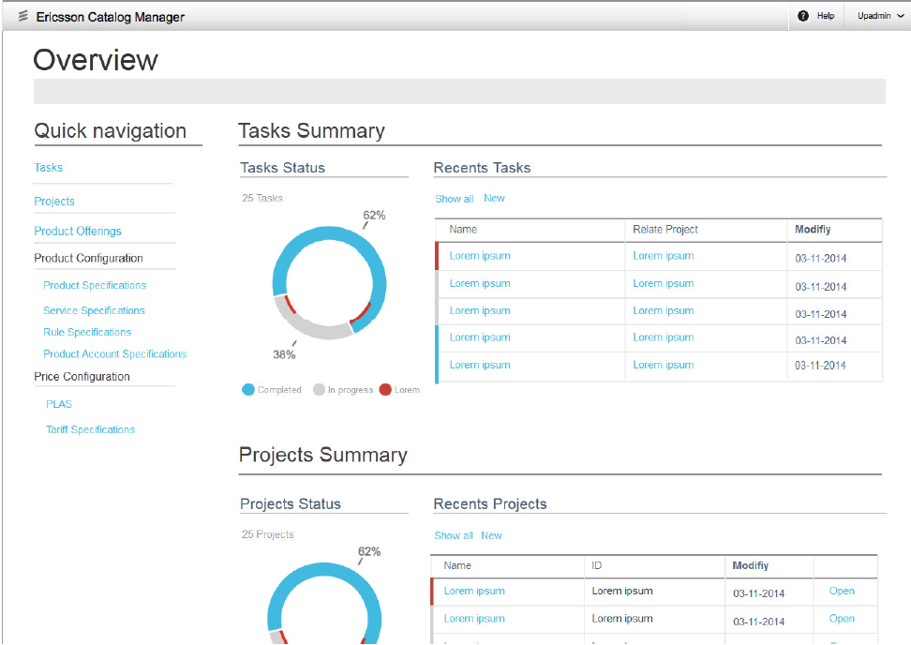
Role-Based User Interface
Release 14.0 GA
New User Interface Features
Role-based views
Dashboard
One click navigation
Reduced pop-ups
Editable lists
PLM focused through-out
Drag and drop capability
Result
More intuitive user interface better suited for non-technical user while keeping proven tool power intact
P2

Slide 37
Today’s Agenda
ERICSSON VISION AND STRATEGY
ERICSSON CATALOG MANAGER RELEASE 14 ENHANCEMENTS AND ROADMAP
ERICSSON ORDER CARE RELEASE 14 ENHANCEMENTS AND ROADMAP
BEST PRACTICES FOR UPGRADING TO 14.X
WRAP-UP AND Q&A

Slide 38
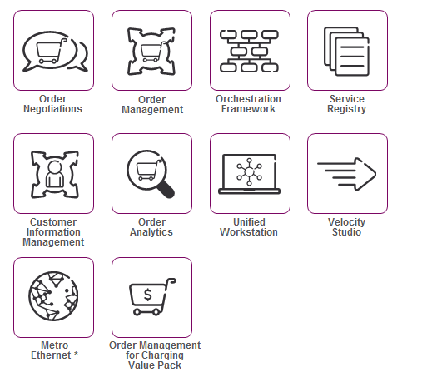
Ericsson Order Care Portfolio
Product Components
Supported Solutions
Ericsson Service Innovation Framework
Ericsson Mobile Order Management
Product Catalog
Product
Lifecycle
Designer
* Roadmap item; not available for tendering

Slide 39
Ericsson Order Care
Roadmap Focus Areas
Integration
with Ericsson
Lead-to-Service
Products
ARCHITECTURE
User Interface Evolution
Compliance to TM Forum Processes and APIs
ERICSSON ORDER CARE
USER EXPERIENCE
Out-of- the-Box User Dashboards and Operational Workflows
Productized
Industry Best Practices Metadata Implementations
Scalable, Integrated, Modular Applications
PLATFORM

Slide 40
Ericsson Order Care roadmap overview
Release 14.1
Release 14.2
Release 16.0
User Experience
Ericsson ‘look and feel’ adaptation and enhancements
Architecture
Integration with Ericsson Charging System (OM)
TM Forum compliant RESTful APIs (ON, OM, SR)
Platform
Support for catalog-driven fulfilment
OM: Catalog-driven componentized order support
OM for Charging System Value Pack
User Experience
UWS Evolution to HTML5-based UI
OOB user dashboards and TM Forum eTOM workflows
Architecture
Integration with Ericsson Multi Service Delivery Platform, Granite Inventory, Ericsson Multi Activation and Ericsson Experience Manager
Platform
Enhanced Configuration, Price, and Quote (CPQ) capabilities
Metro Ethernet Services Value Pack
User Experience
Application module native UI enhancements/upgrade to HTML5
Quad Play UI wizards and task-based operational workflow enhancements
Architecture
Integration with Ericsson Telecom Customer Relationship Management
Platform
Quad Play Services Value Pack
Cloud readiness evolution towards Software as a Service (SaaS) operations
14.1
14.2
16.0
Q4
Q1
Q2
Q3
Q4
Q1
Released
Indicative
Candidate
2014
2015
2016

Slide 41
Select Features
Release 14.1 GA
REST APIs
New Interface Provider in platform allowing REST support
Standard compliance for REST APIs based on TM Forum specifications
Order Negotiations
SID* / TM Forum based REST API support
Additional support to catalog relationship
Additional support for non-catalog items
Service Registry
SID* / TM Forum based REST API support
Order Management
SID* / TM Forum based REST API support
Expose OM fulfillment for execution as a service
Orchestration Framework
Enhanced Fulfillment Plan Specification (FPS) to provide workflow Checkpoints
Enhanced OF to support dynamic construction of Fulfillment Plan Instance’s (FPI)
*Shared Information and Data (SID) Model

Slide 42

Metro Ethernet
Release 14.1 GA
BENEFITS
Accelerates time-to-market for Metro Ethernet launches
Pre-configured solution drives down total cost of ownership
Metro Ethernet Forum standards compliance facilitates back-end office integration compatibility
A pre-configured Ericsson Catalog Manager and Ericsson Order Care solution for Metro Ethernet
Ericsson Catalog Manager model leverages TM Forum and Metro Ethernet Forum standards
Ericsson Order Care provides fully customizable Configuration, Price and Quote (CPQ) capability and Order Lifecycle Management and Handling
Pre-defined fulfilment workflows and business layer interaction logic delivers robust automation

Slide 43
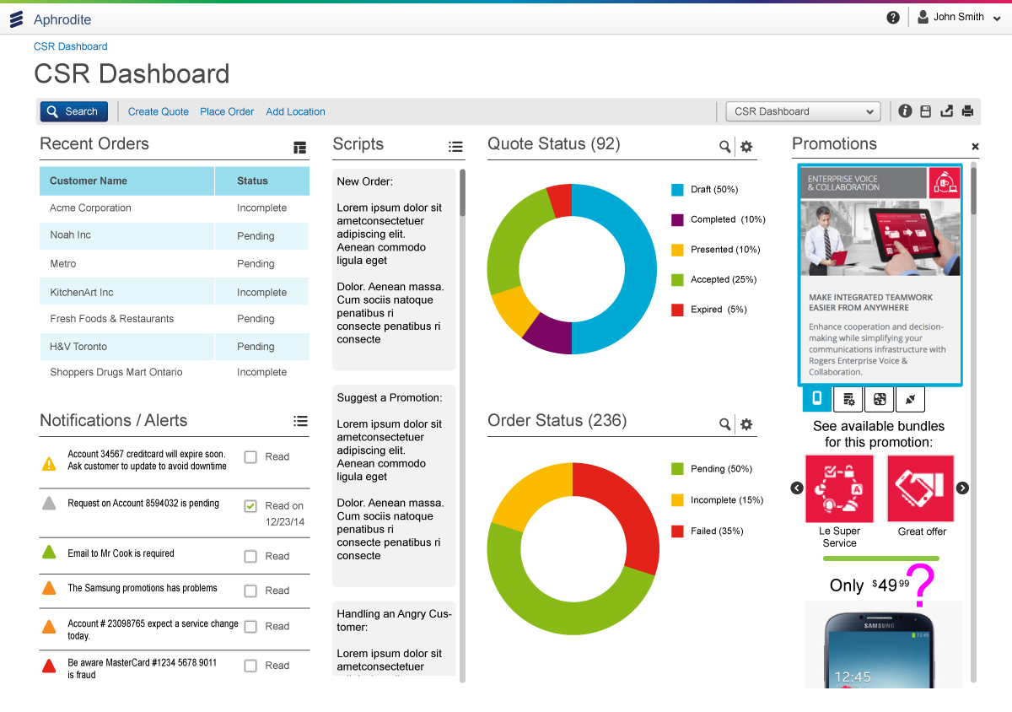
UNIFIED WORKSTATION Evolution
Release 14.1 GA
Introduction of new, enhanced HTML5-based User Interface
Pre-configured user dashboards and operational workflows to support Metro Ethernet services
One-click access to key info and processes

Slide 44
Today’s Agenda
ERICSSON VISION AND STRATEGY
ERICSSON CATALOG MANAGER RELEASE 14 ENHANCEMENTS AND ROADMAP
ERICSSON ORDER CARE RELEASE 14 ENHANCEMENTS AND ROADMAP
BEST PRACTICES FOR UPGRADING TO 14.X
WRAP-UP AND Q&A

Slide 45
Why Upgrade to 14.x?
Benefit from platform fixes and enhancements
Get access to new features
Get the latest product certifications
Ensure backward compatibility

Slide 46
Step 1: Perform Solution Review
Component | Needs Detail Review? | Notes
Customer Information Management Orchestration Framework Order Management | No | New features
Service Registry | Yes | Impacts related to Unified Workstation, Ericsson Catalog Manager
Unified Workstation Order Negotiations | Yes | Impacts related to Ericsson Catalog Manager, New Unified Workstation
Ericsson Catalog Manager | Yes | New Model
Integrations | No | Limited change
Data Model | No | Limited change
Operations Environments | No | Limited change

Slide 47
Step 2: EVALUATE your solution and operational needs
What modules are being used?
Which version are you on now?
How much customer adaptation is in place?
Evaluate product release notes of changes
How to manage current enhancement activities on existing platform?
Determine new environments for development, system integration, load testing, and production, etc.
Data migration
Training for staff on 14.x
Determine deployment plan based on your evaluation

Slide 48
Step 3: DETERMINE Level of effort NEEDED
Scope | Low Effort | Med Effort | High Effort
Ericsson Order Care | Limited Change | New Catalog Model with Order Management only | New Catalog Model with Order Negotiations/ Unified Workstation
Interfaces | Limited Change |  | New Rest API
Unified Workstation | As is |  | New Model
Ericsson Catalog Manager | As is model | New Model
Service Registry | As is catalog model |  | New Catalog Model
Data Model | Limited Change
Operations, Environments | Limited Change
Training | Limited Change
Adaptations | Customer-specific

Slide 49

Step 4: UPGRADE YOUR SOLUTION
Recommended process:
Set up environment
Install any new 3rd party software, if required
Install Ericsson Order Care and Ericsson Catalog Manager (standard installation with modules)
Migrate existing metadata (import, migrate)
Upgrade database (generated upgrade script)
Evaluate and correct errors for deprecated features
Implement any new features
Perform regression test execution
Implement deployment plan

Slide 50
DEPLOYMENT Implementation PHASES
PHASE 1
Install environments
Install Software
Analyze Metadata
Analyze Release notes
training
Build work plan
Estimated Timeframe 1 month
PHASE 2
Migrate
Catalog model changes
Unified Workstation/ User Interface changes
New feature introduction
Data Migration
Unit testing
Estimated Timeframe 1 – 4 months
PHASE 3
Final preparation
Functional Testing
Regression Testing
Operational readiness
Estimated Timeframe 2- 4 months
PHASE 4
Production deployment
Data Migration
Limited launch
Estimated Timeframe 3 months

Slide 51
Today’s Agenda
ERICSSON VISION AND STRATEGY
ERICSSON CATALOG MANAGER RELEASE 14 ENHANCEMENTS AND ROADMAP
ERICSSON ORDER CARE RELEASE 14 ENHANCEMENTS AND ROADMAP
BEST PRACTICES FOR UPGRADING TO 14.X
WRAP-UP AND Q&A
P3

Slide 52
Measurable Success
90%
70%
36%
FLOWTHROUGH
IMPROVEMENT
INCREASE
improved from 55%
in first call resolution
total number of services offered
5
5
6
MINUTES ORDER TO DISPATCH
FOLD REDUCTION
WEEKS service Introduction
reduced from 5 days
in time to process customer call
reduced from months
200%
80%
150%
INCREASE
FEWER
MORE
work managed by current staff
missed due dates
orders processed every day
FASTER SERVICE DELIVERY
IMPROVED CUSTOMER EXPERIENCE
NEW AND ACCELERATED REVENUE
Notes:
1/19/20152011-10-19
52
Sharpen Your Operations
Met benchmark of 8 million orders per month
Handling ~50 interfaces to a variety of systems
Improved customer experience with faster activation: from hours to minutes
Processes that took hours now take seconds
150% increase in daily total of orders processed
36% increase in total number of services offered
Manual order handling reduced from 10 touch points to 4 for 70% of orders
Time from order to dispatch reduced from 5 days to 5 minutes
Lead time for service delivery reduced from 4-6 weeks to 2-5 days

Slide 53
WHY INVEST IN ERICSSON Lead-to-Service?
“Ericsson is the market share leader in the global application software market, with a pre-integrated, modularized OSS suite.”*
IMPROVING FINANCIAL EFFICIENCY
Consolidate and optimize the entire process of managing and fulfilling orders to all markets on any technology
CxO TOP PRIORITIES
ENHANCING CUSTOMER EXPERIENCE
Deliver all service types consistently and accurately, providing timely status to any person or system
INCREASING & ACCELERATING REVENUE
Gain faster time to market and automate the delivery of even the most complex offers and bundles
Source: Gartner 2014 Magic Quadrant for OSS
Notes:
Analysis Mason 2014 Fulfillment Market drivers:
Increasing subscriber numbers in emerging markets and for new-generation technology services
Growth in the number of connected devices
CSP initiatives to counter OTT services
Take-up of M2M services
New packet network technology deployments
System convergence
Investments in automation to reduce opex
‘Double-sided’ business models
Focus on enterprise and SME markets
National broadband infrastructure stimulus programmes
CSPs offering cloud services

Slide 54
Q&A
?

Slide 55
For More Information
Contact your Ericsson sales representative
Look for webinar replay and download instructions
Send us an e-mail: claudia.gilmour@ericsson.com
Please respond to brief survey
THANK YOU!

